Slide 1
HAND GESTURE CONTROLLED
A human-computer interaction system using hand gesture by cheap alternative to depth camera.

Slide 2
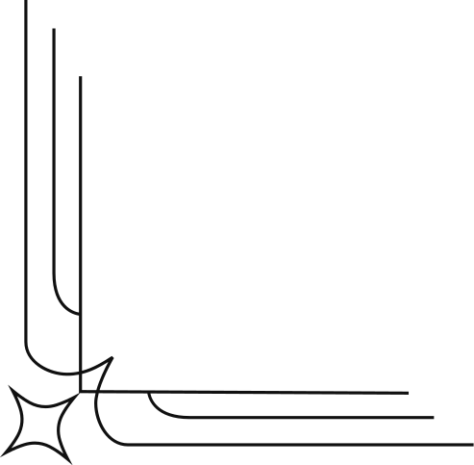
Introduction
Defination Of Gesture
Basic Working Of Gesture
Applications
Model Overview
Abstract
Literature Study
Requirement Analysis Modules
Index

Slide 3
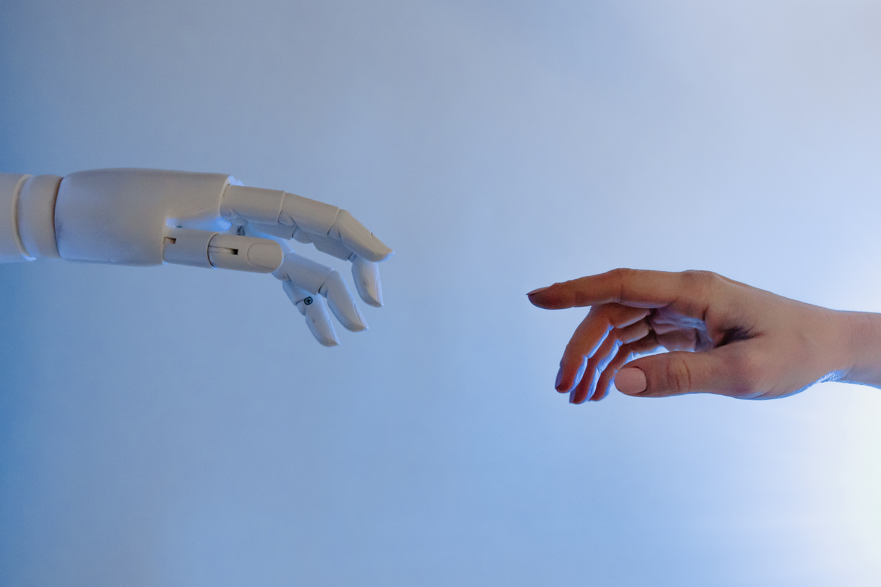
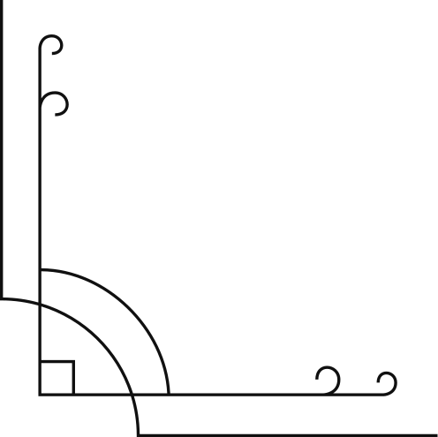
What Is Gesture?
A Gesture is a form of non-verbal communication in which visible bodily actions communicate particular messages, either in place of speech or together and in parallel with words. Gesture include movement of the hands, face, or other parts of the body.

Slide 4
Basic Working Of Gestures

Slide 5
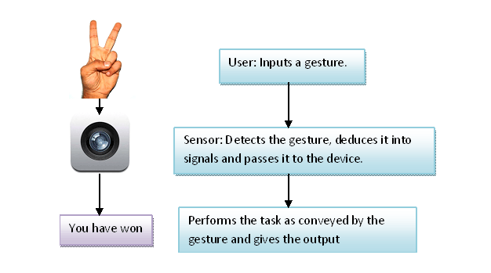

Slide 6
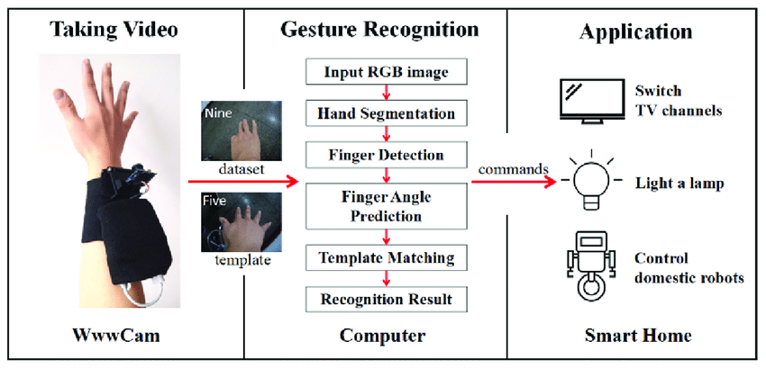

Slide 7
HAND GESTURE RECOGNITION
VISION GESTURE RECOGNITION
SIGN LANGUAGE RECOGNITION
ELECTRICAL FIELD RECOGNITION ETC.,
Types Of Gestures

Slide 8
Applications of Hand Gesture Recognition Technology
Automotive
The BMW 7 Series has a built-in HGR system that recognizes five gestures and can control music and incoming calls, among other things. Less interaction with the touchscreen makes the driving experience safer and more convenient.
Healthcare
Emergency rooms and operating rooms may be chaotic, with lots of noise from personnel and machines. In such environments, voice commands are less effective than gestures. Touchscreens are not an option either, since there’s a strict boundary between what is and is not sterile. But accessing information and imaging during surgery or another manipulation is possible with HGR tech, as proven by Microsoft. GestSure provides doctors with the ability to check MRI, CT, and other imagery with simple gestures without scrubbing out.

Slide 9
Virtual reality
A hand tracking application from ManoMotion recognizes gestures in three dimensions using a smartphone camera (on both Android and iOS) and can be applied in AR and VR environments. The use cases for this technology include gaming, IoT devices, consumer electronics, and robots.
Consumer electronics
These days, the consumer market is open for new experiences in HMI, and hand gesture recognition technology is a natural evolution from touchscreens. Demand for smoother and more hygienic means of interaction with devices as well as a concern for driver safety are pushing the adoption of HGR in industries from healthcare to automotive and robotics. And while software development for gesture recognition systems is quite challenging, expertise in AI, deep learning, computer vision, and innovative hardware from top tech providers make HGR solutions more affordable than they were even a few years ago.

Slide 10
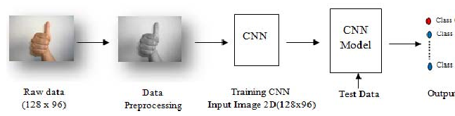
CNN - Model Overview

Slide 11

Abstract

Slide 12
We are going to illustrate about Controlling PowerPoint Using Hand Gestures. Presentations are important in a variety of spheres of life. Everyone who has ever worked in an organization or been a student has delivered demonstrations at some point in their lives. When you have to update and operate the slides using the keyboard or a special device, PowerPoint presentations can occasionally become less engaging. This work focuses on the creation of interactive projection technology, which makes viewing more engaging and dynamic by instantly identifying the user's motion. We wanted to make it possible for users to control the slideshow with hand gestures.

Slide 13
Through gestures, the PowerPoint slideshow's various functions have been attempted to be controlled in studies. This study attempted to map tiny distinctions in gestures with some basic PowerPoint slide show controlling Python programs. Machine learning was utilized to recognize the gestures.
A few years ago, gesture detection became increasingly important for controlling software like media players, robots, and games. The utilization of gloves, markers, and other objects is enhanced by the hand gesture recognition system. Hand gestures make communication easy, useful, and independent of any added technology. The suggested approach is designed to assist speakers in giving fruitful presentations by improving their natural interaction with the computer. In particular, the suggested technique is more practical than using a laser pointer because the hand is more obvious and may thus better capture the audience's attention.

Slide 14



Literature Study

Slide 15
In deep learning there are two modes of pattern recognition: one is vision based-Vision based is too dependent on the externalenvironment. The other one is sensor based-which needs sufficient light and background environment. The technique is carriedout in such a way that in the data collection they have used attitude sensor and data is collected in large amounts. The next stageis to capture the data i.e., the starting and the end points of the gesture should have an effective signal segments to be processed. Next, they are going to use the data for the better reflects of input characteristics. At the last they are going to classify the largeamounts of data and post-process it. The conclusion is they have implemented gesture recognition algorithm based on gesturesensor.
Gesture recognition is the mathematical interpretation of a human motion by a computing device. This application is generallydivided into two categories i.e. contact-based approach and vision-based approach. The vision-based approach is simpler and itemploys video image processing and pattern recognition. In this paper they have trained CNN classifier to determine the shape ofthe hand. In the vision-based approach they have avoided the skin color segmentation. The aim is to recognize six static and eightdynamic gestures while maintaining accuracy and speed of the system and the recognized gestures are used as command to thecomputer.
The hand gesture system is used been more in now a days because it helps in the interaction between the humans and machine. Inthis paper they have used hand for recognition is because it gives more meaningful information when compared to the other typeof gestures. The principal component of the hand gesture recognition system includes segmentation and tracking hand from the background and then the feature is extracted from the segmented hand image using various algorithms and finally we are going torecognize the hand gestures. Hand gesture recognition is used in many applications like- HCI, robotics, sign language, digit and alphanumeric value. In this paper they have used Kinect sensor which is used widely in comparison of vision-based technologyand glove-based method. Recognition of dynamic hand gesture needs more computation in comparison to static hand gesture.

Slide 16
The study about dynamic gesture motion tell us about how feature vectors are obtained using the tangential angles. Thefeature vector is obtained by the tangent angle of the motion path of the palm. To solve the classification identification problem,they have used the Forward-backward algorithm and then they have used the Viterbi algorithm which solves the category of theoptimal trajectory sequence. To train the parameter model they have used the Baum-Welch algorithm. In the last stage they haveused D-S evidence theory to carry out model feature fusion to realize dynamic gesture recognition.
Blind peoples are facing many problems in their daily life and the most critical ones are reading and writing. They feelcommunication medium difficult because they cannot access the computer. A real time embedded system is used to interactwith an external environment, which may be any living organisms. In Braille script six dots represent the six fingers. They haveused microcontrollers in this paper which intakes the gestures and sends the input to the computer. The computer recognizes thegesture and prints it on the display as an output. The system is very cost effective when compared to other typographicalsystem.
As the technology is growing rapidly in the daily life the use of gadgets is also increasing. So, to make smart machines we areenabling our machine to take the command by recognizing the different hand gestures which we are going give as a input. Lateron, we put the inputs to databases assigning it some task. Now when we give some commands to our system by hand gesturesthen machine first captures the command as an image then we are going to compare this with the database and if any image isfound in the database then task assigned to that will be performed.

Slide 17
According them hand gesture recognition system provides Human Computer Interaction. The two major applications they haveused is Sign Language Recognition and gesture-based control. Gestures are expressive, meaningful body motions involving physical movements of the fingers, hands, arms, head, face, or body. Hand gesture recognition system is considered as a wayfor more intuitive and proficient human computer interaction tool. The range of applications includes virtual prototyping, signlanguage analysis and medical training.
Presenting with real-time continuous gesture recognition of sign language-first by taking the gesture input followed by thestatistical analysis based on posture, position, orientation, and motion. sign language is the most expressive way for the hearingimpaired, recognizer must be able to recognize continuous sign vocabularies in real-time. We use End-Point problem todetermine the end points in a gesture input sequence.
Hand gesture based electronic device control is gaining more importance nowadays. This paper presents hand gesturerecognition-based Device control by using microcontroller. The purpose of project is to design & develop a hand gesture-basedDevice control which can be easily controlled by the help of gesture recognitionsystem.Experimental investigation proves thestable robustness, performance and high accuracy of the proposed device controller.

Slide 18

Requirement Analysis Modules

Slide 19
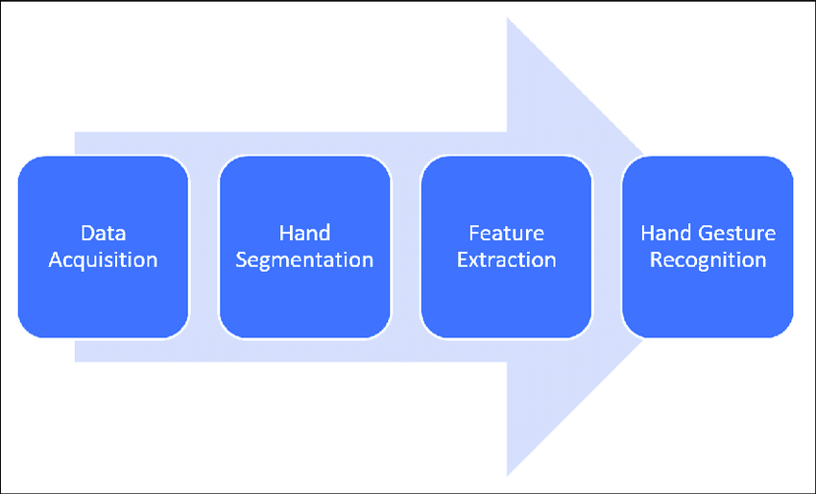

Slide 20
Data Acquisition, Camera module:
This module connects to and collects input from several image detectors before sending the image to the detection module for processing in the form of frames. Data gloves, hand belts, and cameras are the three most used input-capture devices. Our system uses the built-in webcam, which is an economical way to detect both static and moving movements. The system is set up to accept input from a USB-based webcam as well, but doing so would cost the user money. The resultant visual frames are presented as a video.
Hand Segmentation, Detection module:
This module is responsible for the image processing. The output from camera module is subjected to different image processing techniques such as colour conversion, noise removal, thresholding following which the image undergoes contour extraction. If the image contains defects, then convexity defects are found according to which the gesture is detected. If there are no defects, then the image is classified using Haar cascade to detect the gesture. In the case of dynamic gestures, the detection module does the following; If Microsoft PowerPoint has been launched with a slideshow being enabled and the webcam detects palm in movement, for 5 continuous frames then the dynamic gesture swipe is detected

Slide 21
Interface module
This module is responsible for mapping the detected hand gestures to their associated actions. These actions are then passed to the appropriate application. The front end consists of three windows. The first window consists of the video input that is captured from the camera with the corresponding name of the gesture detected. The second window displays the contours found within the input images. The third window displays the smooth thresholded version of the image. The advantage of adding the threshold and contour window as a part of the Graphical User Interface is to make the user aware of the background inconsistencies that would affect the input to the system and thus they can adjust their laptop or desktop web camera in order to avoid them. This would result in better performance.
Output Module:
In this module system gives us the output of the input we give it display through the code. And the data set we provide to the system.

Slide 22
Uses of Hand Gesture Recognition:
This technology can be used to control complex robotics systems, smart appliances, medical devices and mixed reality environments etc.,
Usage Of this Technology in Medical Field:-
There are some situations where voice control is not appropriate or at least less optimal. The ER and OR for instance can be chaotic with a lot of different voices of doctors, nurses and different beeping of machines.
In this environment using voice interface would be tricky, but where gesture control would be better suited and more beneficial.
For instance in situation where nurse and doctor may not touch or reach a screen but still needs to interact with a device with gesture technology could access patient MRI, even make few notes by “Writing” in air. No need of keyboard.

Slide 23
According to the hand gestures, the process of scrubbing out, consulting images using keyboard and mouse and leaving or to step back can take 10 minutes and it can cost the per minute in unto $62.
To resolve this problem, gesture has developed an advantages to MRI, CT and other imagery through simple hand gestures without breaking the sterile field.
So finally in medical field, Through gesture controlled interface wasn’t replace all other user Interface in every situation the technology’s potential is vast.
By eliminating our dependency on keyboard and mouse, thus intuitive touch less interfaces will fundamentally improve how we engage with many sector of the built environment.

Slide 24
Demo Usage Of Hand Gesture In Medical Field :

Slide 25
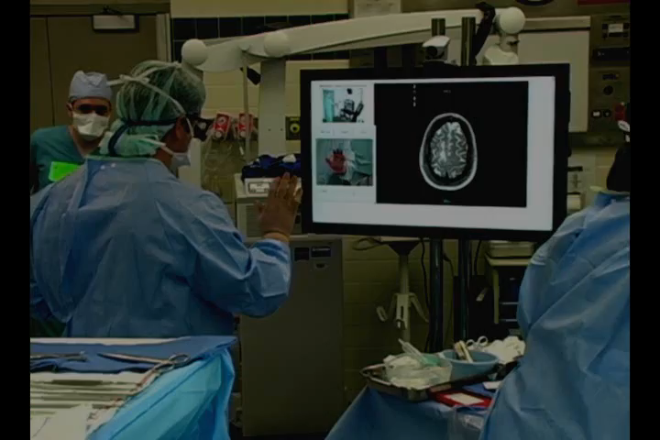

Slide 26
As in the medical field we have seen the usage of hand gesture technology.
As if in presentation purpose one can present the slides in more effectively and efficient way which will be an eye catchy presentation among others participants or colleagues.
Without using mouse and keyboard we can directly use our hands for moving slides forward or backward, write something for explaining and use red dot to represent what and which sentence we are explaining and redo also.
As we have already worked on short distance recognition and implementation. We will be modifying long distance recognition and with more accuracy.

Slide 27
Thank You
for your interest and attention !

